Slide 1

I’ M SHALINI SINGH.
UI / UX SPECIALIST

Slide 2

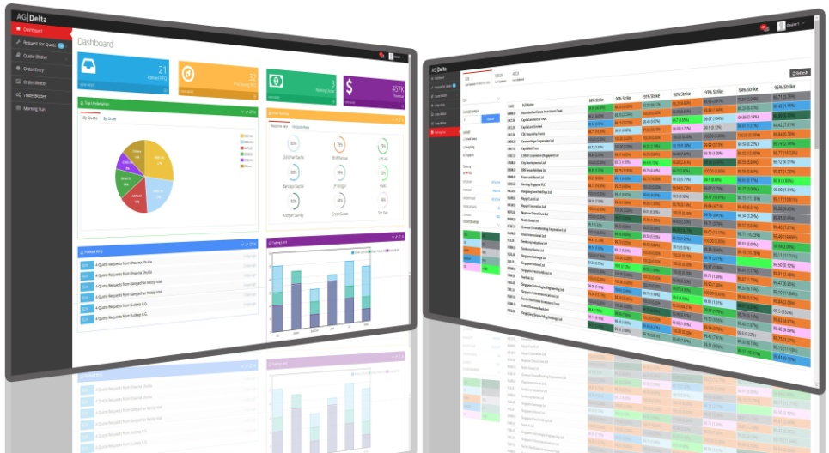

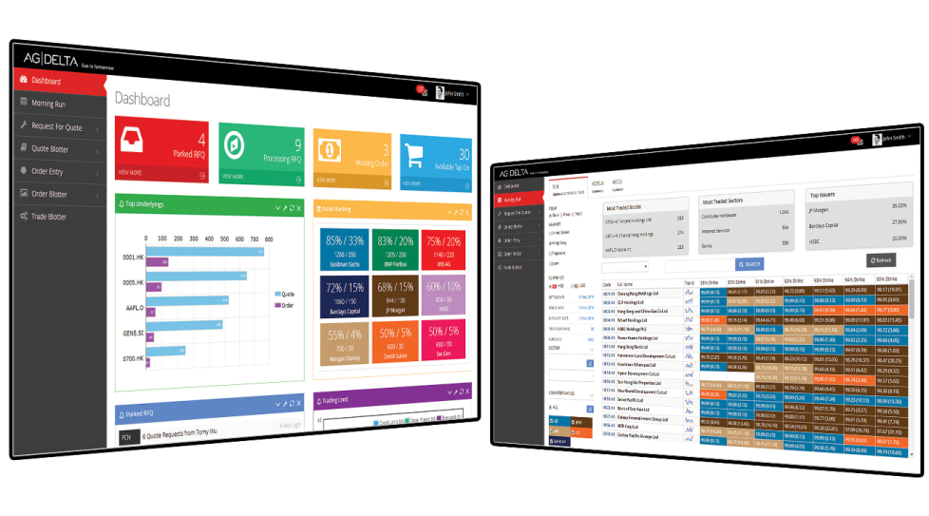
Visualization and Creation of Adv at AGDelta

Slide 3





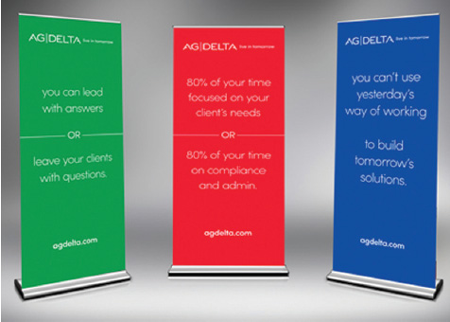


Banners Creation and cards Multilingual at AGDelta

Slide 4
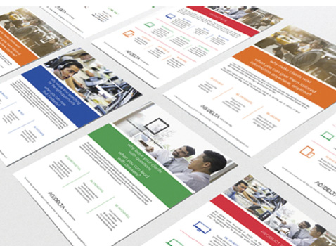
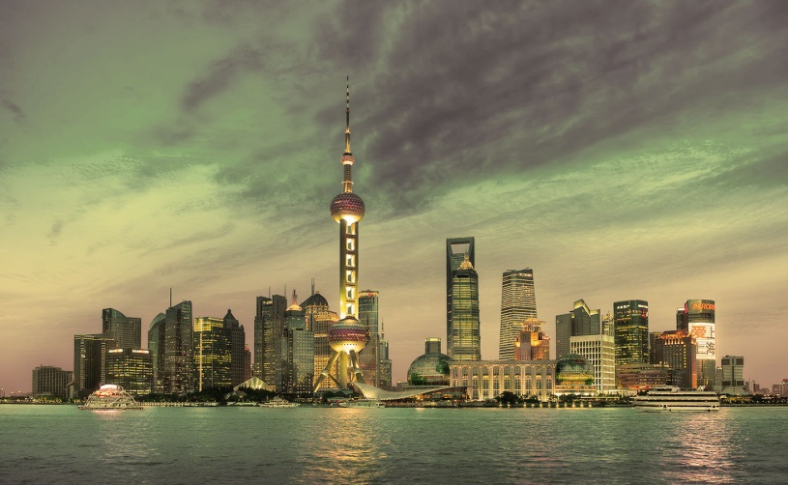
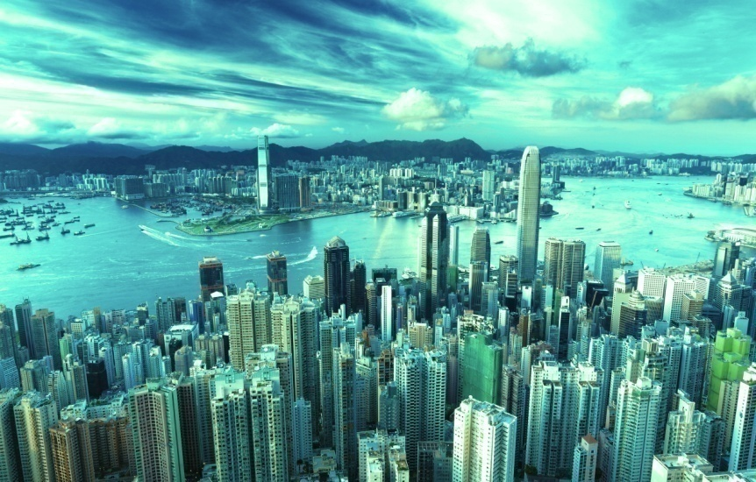

Skylines and brochure creation at AGDelta
China Skyline
HK Skyline
Singapore Skyline

Slide 5
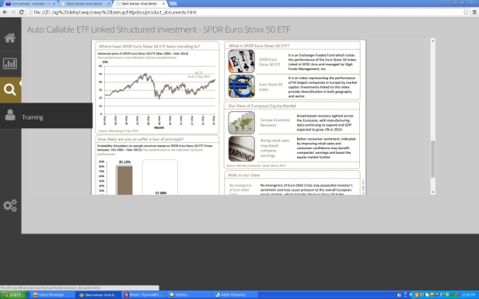
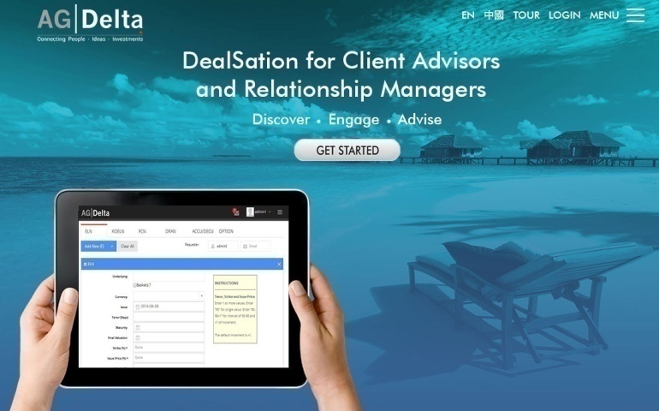
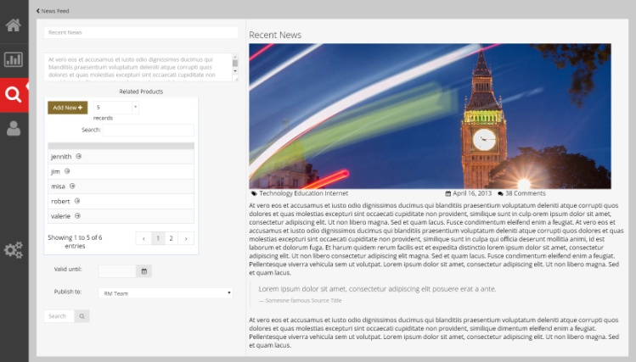
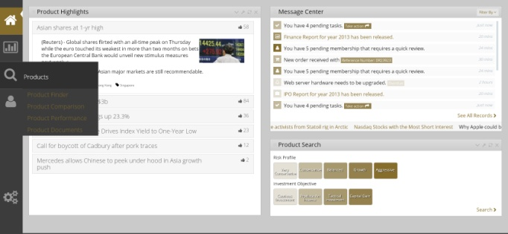
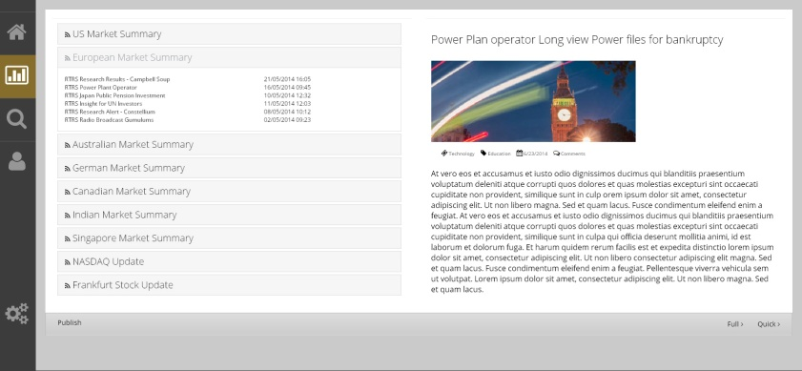
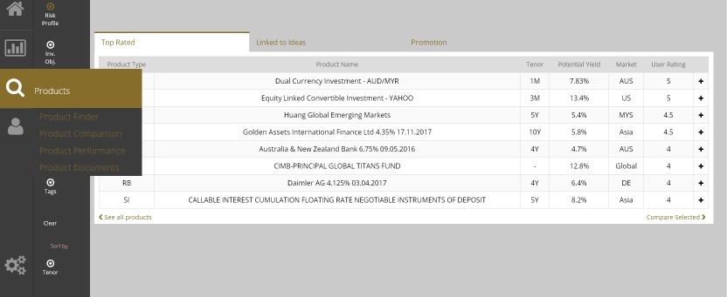
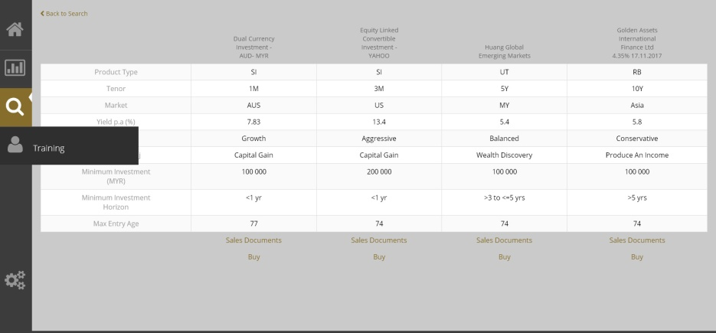
Proposed Android Apps UI as well as real code Design using HTML5, CSS3 and for a Bank

Slide 6
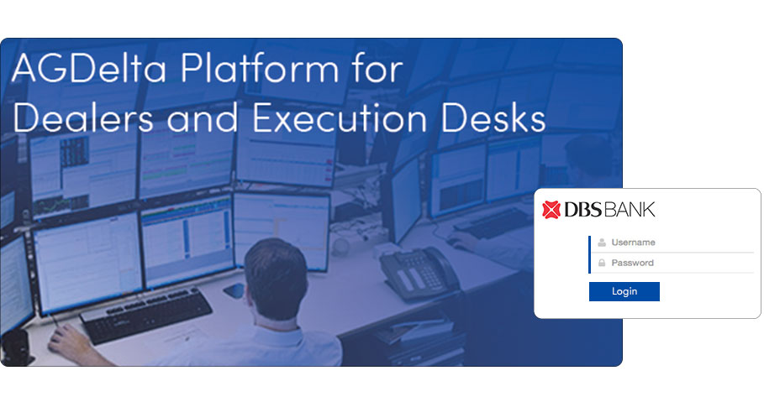
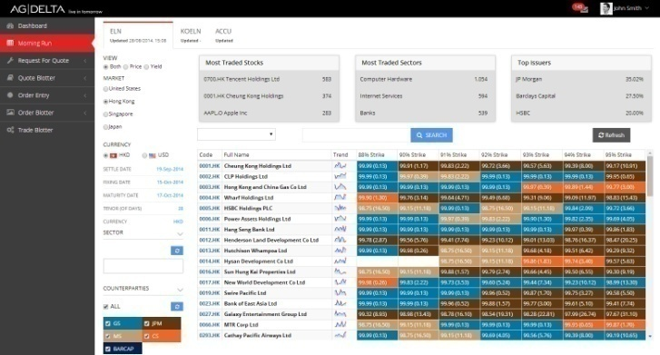
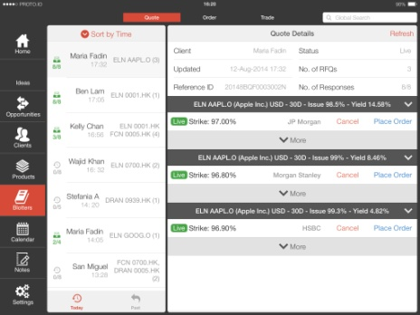
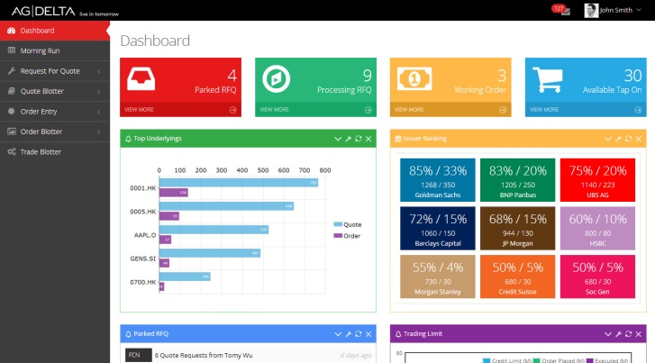
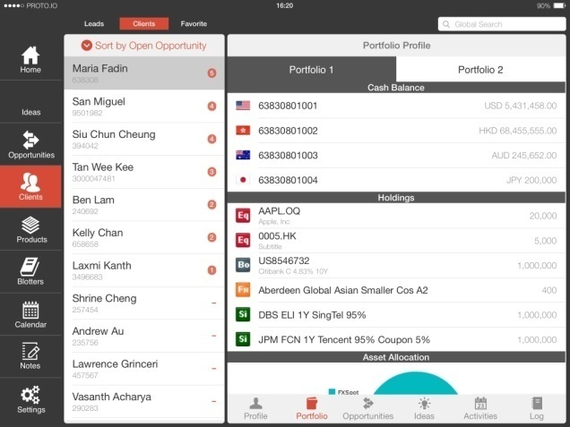
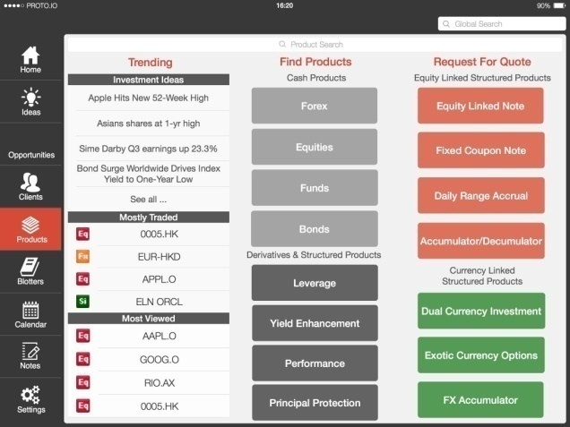
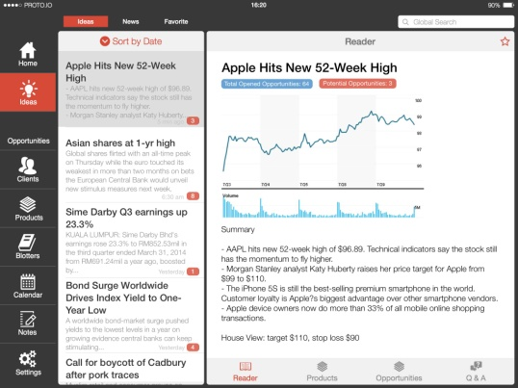
Apps UI as well as hard code generated in HTML5, CSS3 for the RM’s

Slide 7
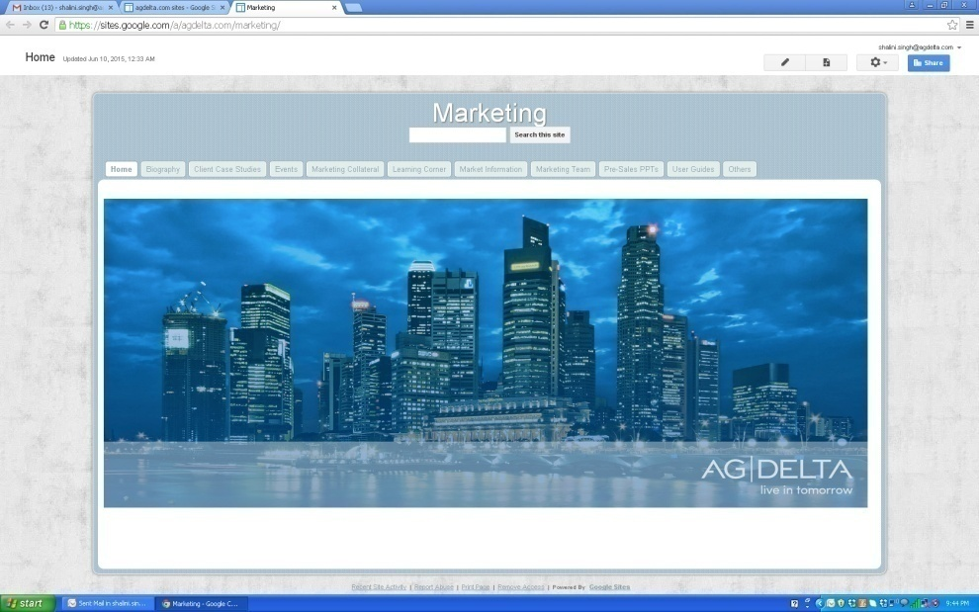
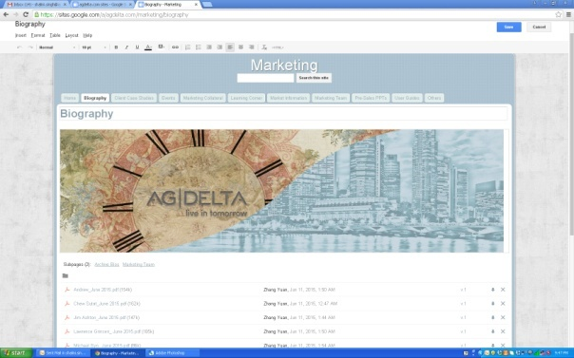
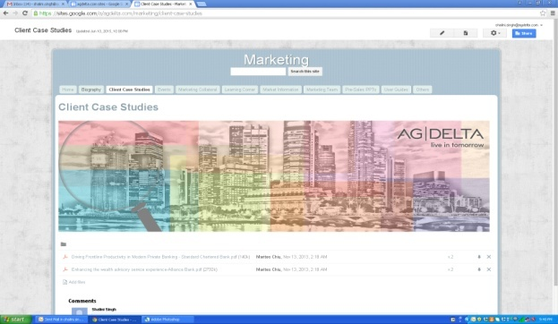
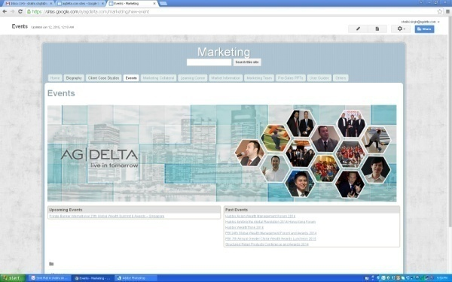
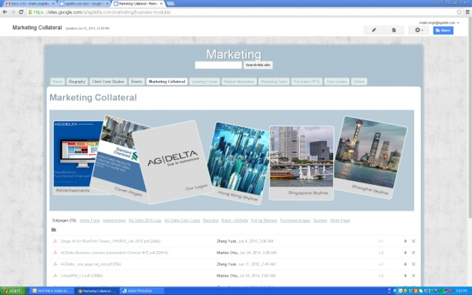
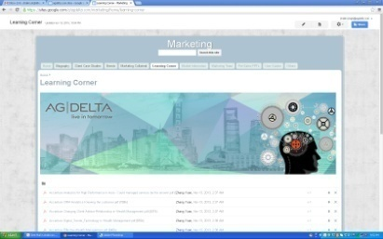
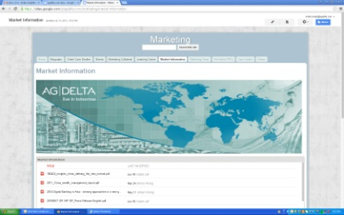
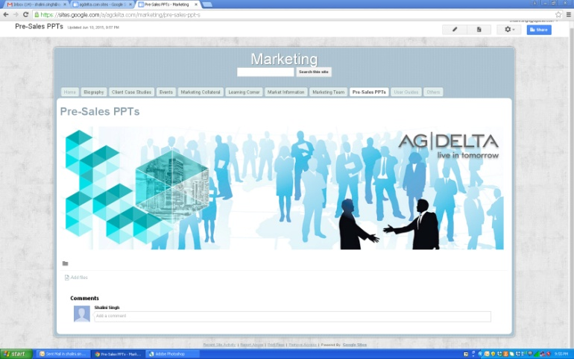
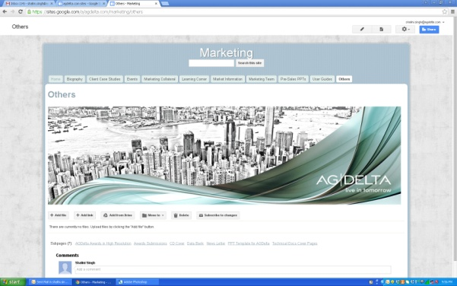
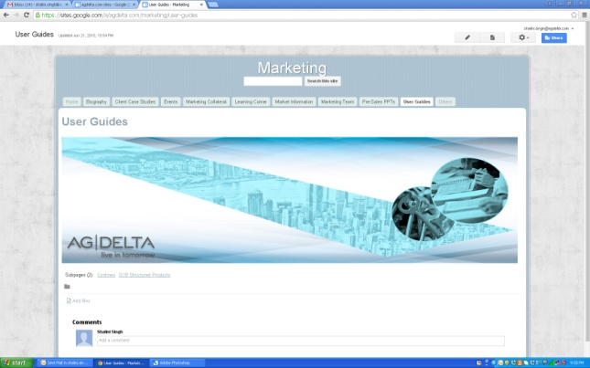
Google Website for Internal stake holders

Slide 8
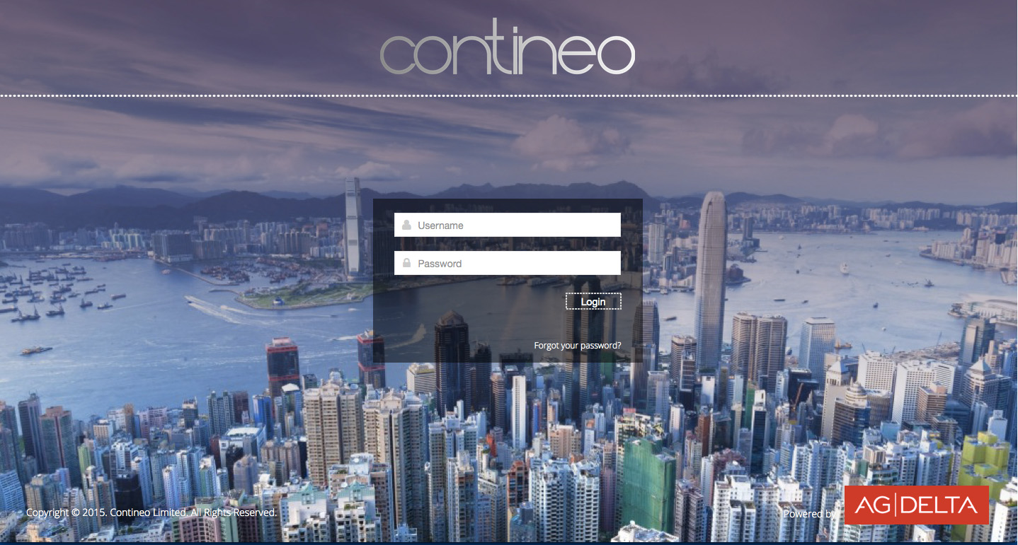
Login Screens for Contineo in Ecllipse (UI and Code)for the Web Apps

Slide 9
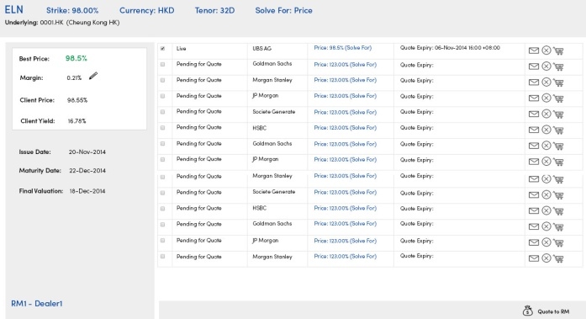
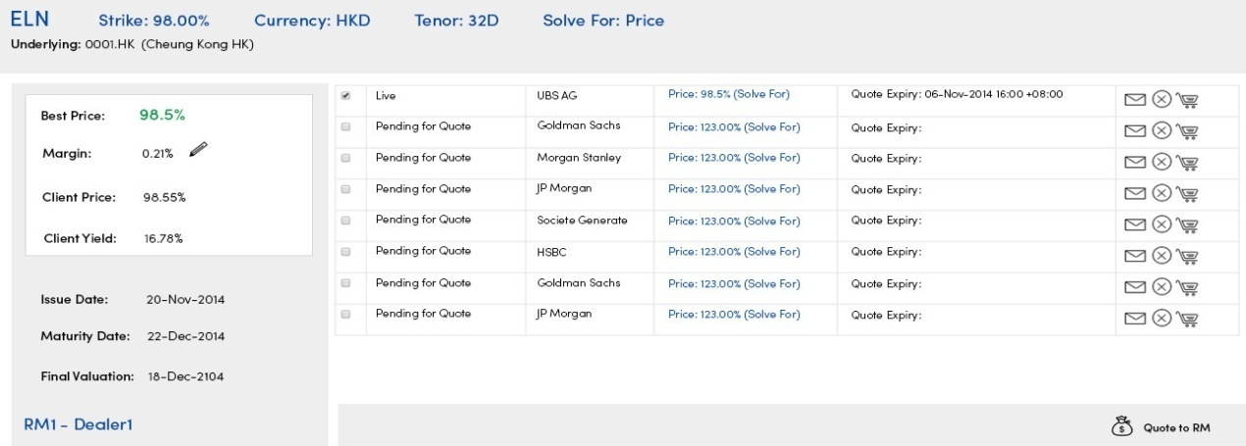
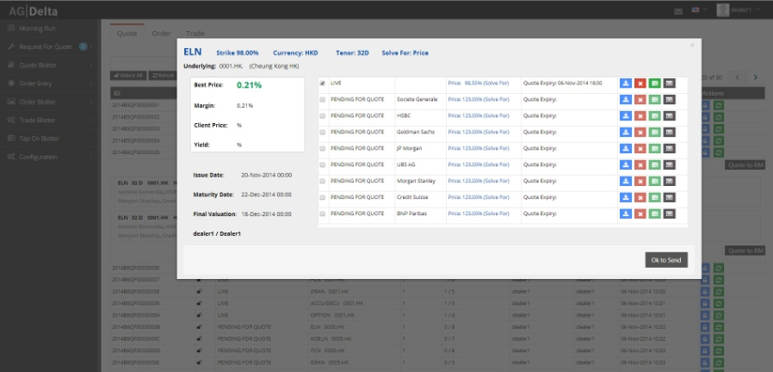
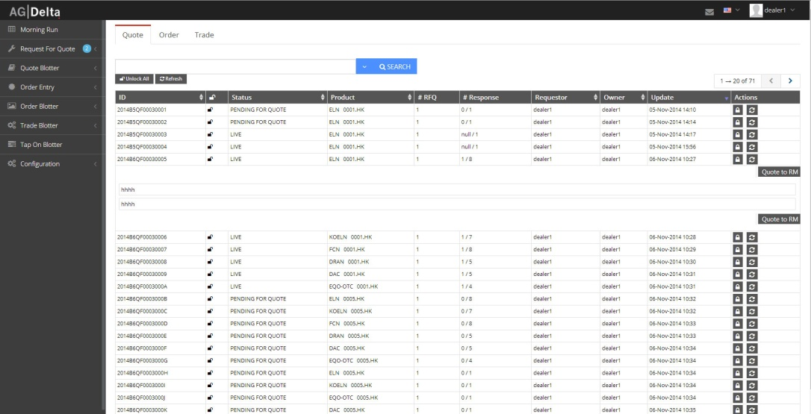
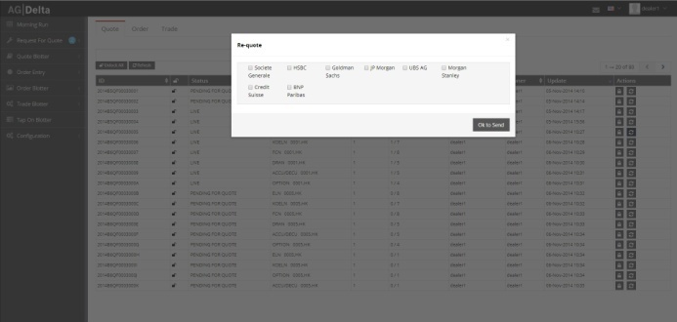
Product Screen design in Visualization, Jpg and Code for RM’s for Barclays
The above are done in JPG to get approval form Client
The below are coded in Eclipse using HTML 5, CSS3 and Angular JS JSON used for fetching date

Slide 10
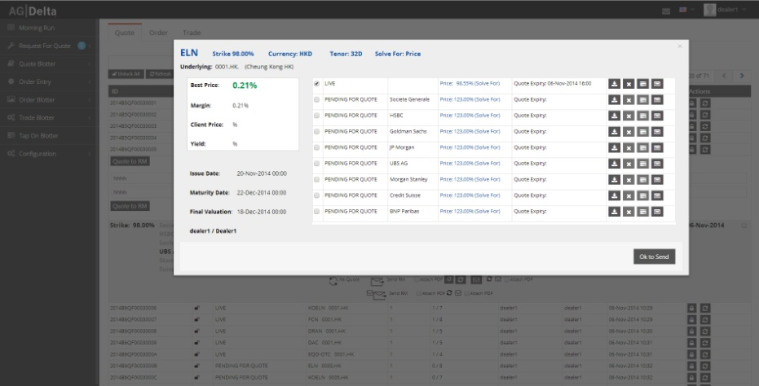
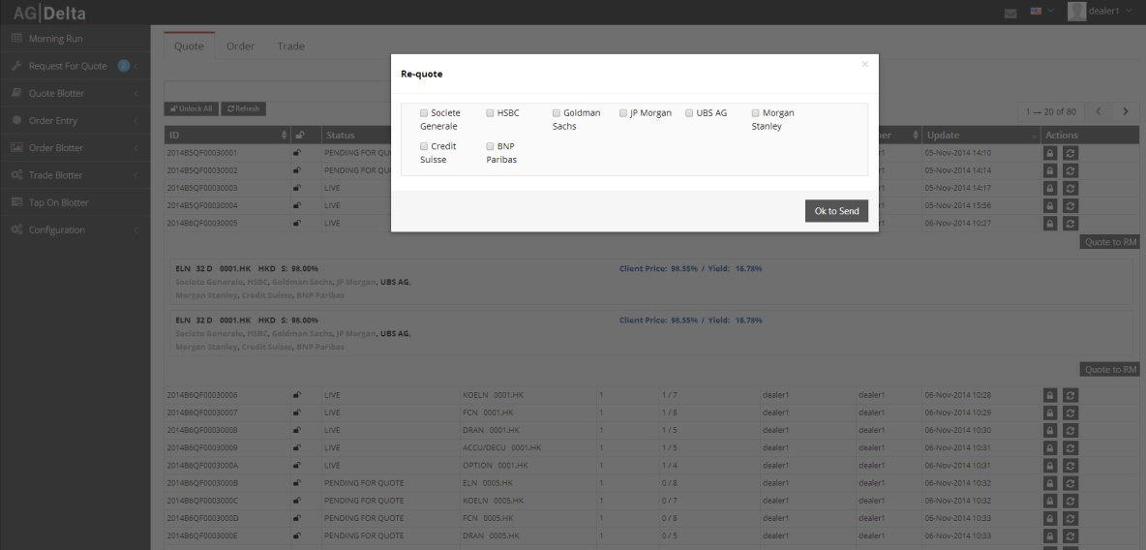
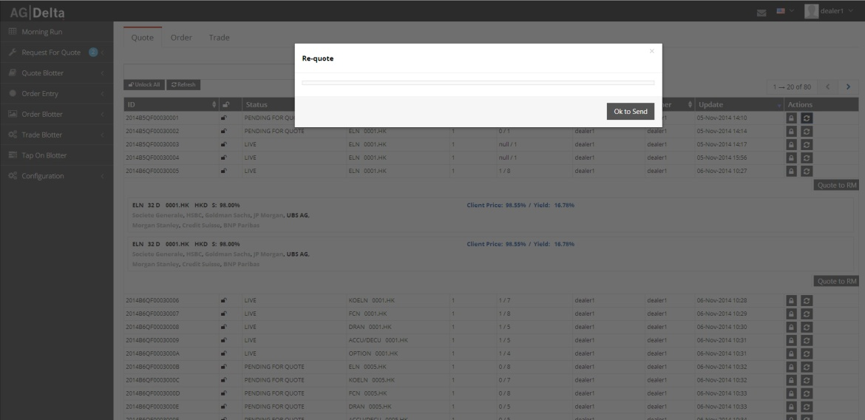
Product Screen Code for RM’s for Barclays

Slide 11
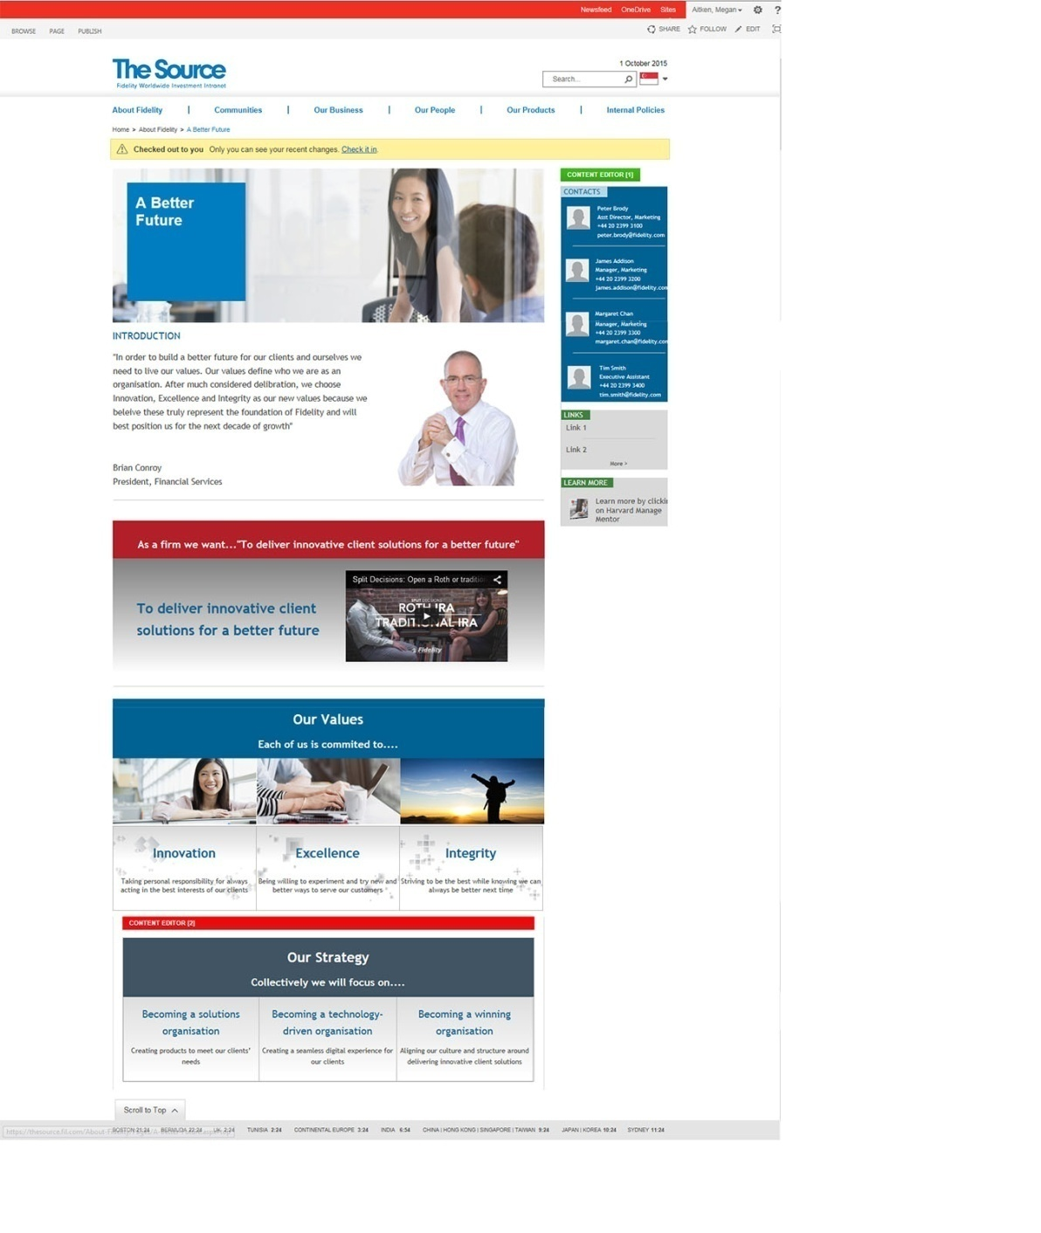
Sharepoint Website for Internal Stakeholders in Fidelity Investments

Slide 12
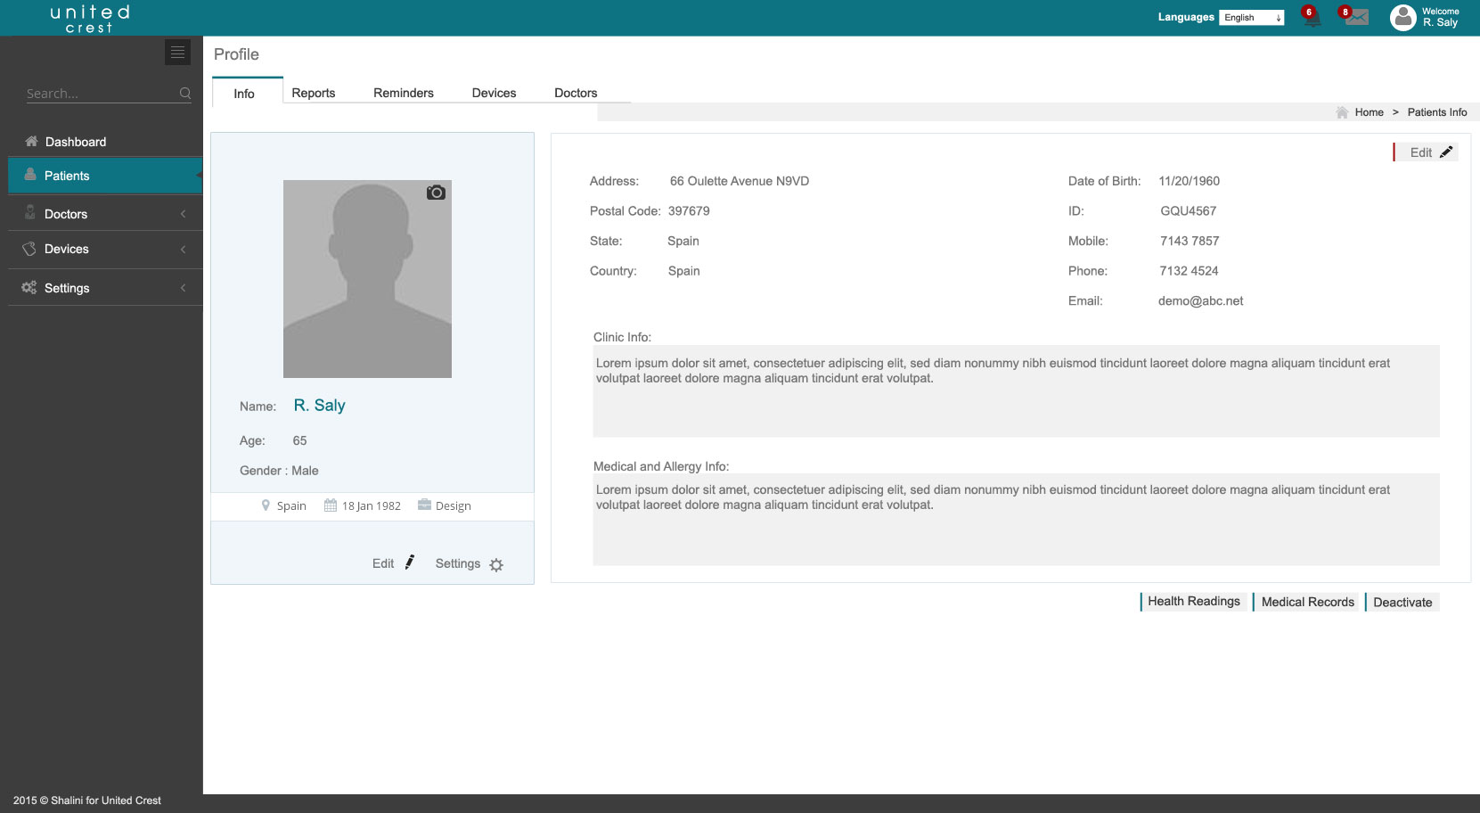
Web Apps Visual Layout for the Patients for the Healthcare Apps

Slide 13
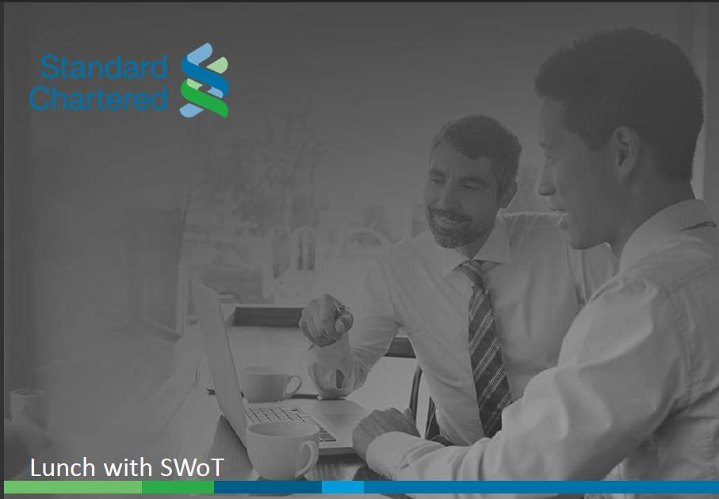
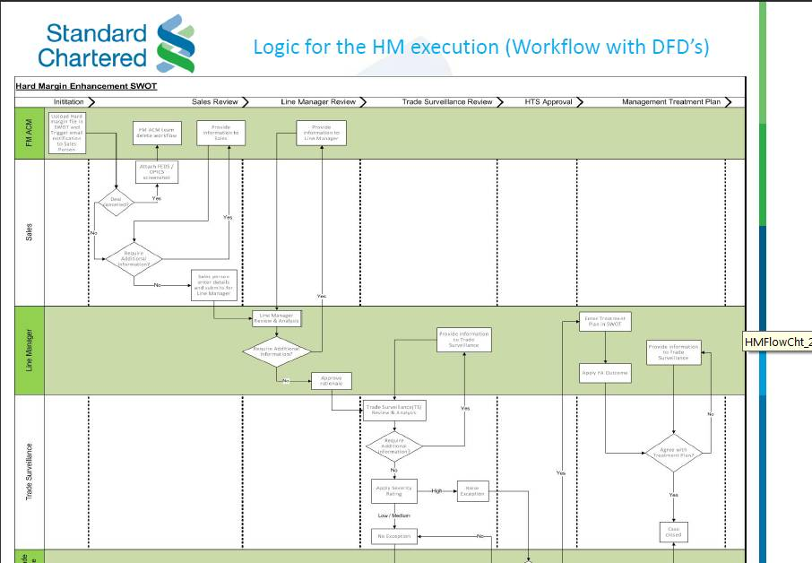
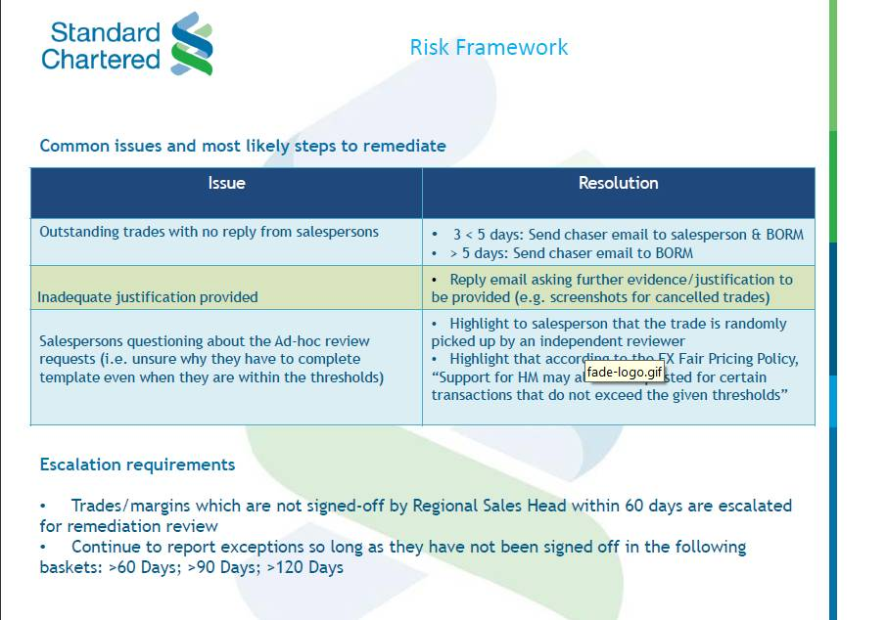

Presentation for Hard Margin explained in the work shop for the CEO’s for an
International Bank

Slide 14
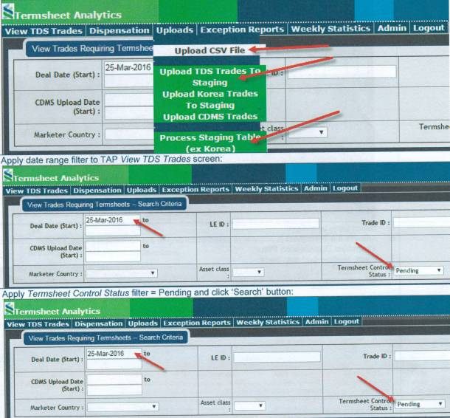
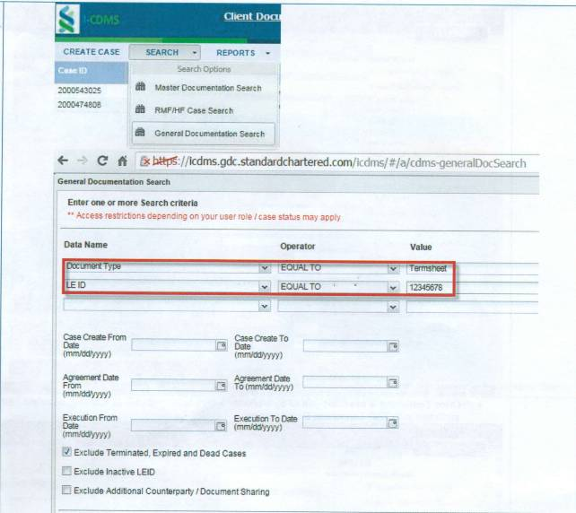
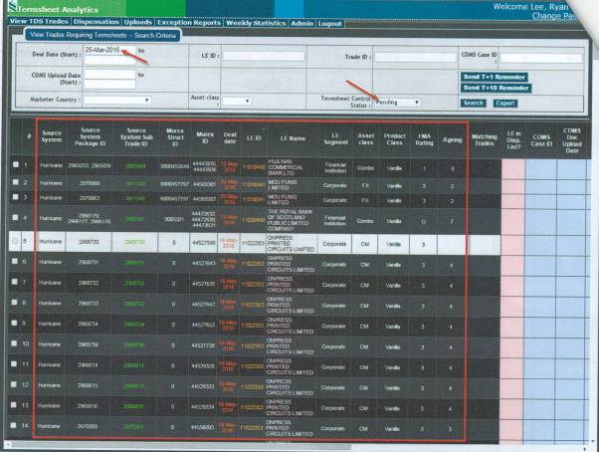
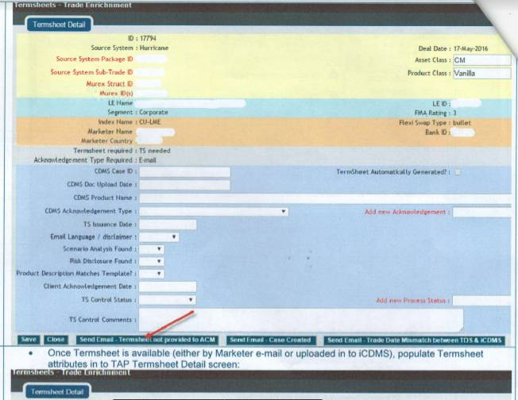
Web Apps for the Termsheet Completeness for an International Bank

Slide 15
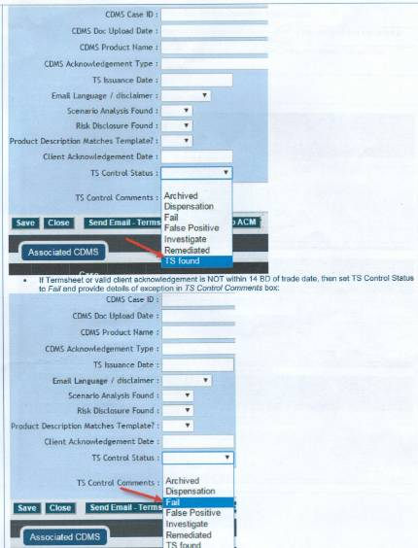
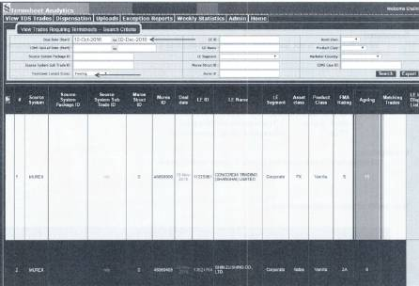



Web Apps for the Termsheet Completeness for an International Bank

Slide 16




Web Apps for the Govt Tech Project at Accenture

Slide 17





Web Apps for the Govt. Tech Project at Accenture

Slide 18




Web Apps for the Govt Tech Project at Accenture

Slide 19





CSV Screens delivered for a Leading Financial Institution Low Fidelity
design in Balasmiq

Slide 20



CSV Screens delivered for a Leading Financial Institution Low Fidelity
design in Balasmiq

Slide 21





CSV Screens delivered for a Leading Financial Institution High Fidelity
design in Figma

Slide 22





CSV Screens delivered for a Leading Financial Institution High Fidelity
design in Figma

Slide 23





CSV Screens delivered for a Leading Financial Institution High Fidelity
design in Figma

Slide 24


Screens delivered for a Media Co. High Fidelity mockup design in Adobe XD for CMS PopTv

Slide 25




Screens delivered for a Media Co. High Fidelity mockup design in Adobe XD for CMS PopTv

Slide 26


Developing and Maintaining for a Media Co. their Beebly website, an online library in Philippines

Slide 27

Auto-Updates and Update Management Customer Research for US Based MNC
To gather feedback from the customer on the concept of automated product updates, with particular focus on auto-updates
notifications, frequency, hosting platform, and manager/end-user process control.

Slide 28

Cruising through Install and Deployment for US Based MNC
To test some possible future concepts for Installation and Deployment in the context of the desired experiences of the end
user and a CAD/BIM Manager. Experiences for Fully Managed, Partially Managed, and Self Managed environments for a
Cloud-based product configuration.

Slide 29





Cruising through Install and Deployment for US Based MNC

Slide 30

Workflow and Wireframe for US Based MNC
To review research materials from the AU 2018 Polaris workshop and derive workflows and wireframes to illustrate the
key scenarios. Mapping the scenario to key problem areas/pain points, describe the customer goal/desired outcome of
the scenario, create a workflow documenting the scenario, creating a conceptual series of wireframe identifying critical data

Slide 31




Workflow and Wireframe for US Based MNC

Slide 32




Workflow and Wireframe for US Based MNC

Slide 33

ATLAS a cloud based app for US Based MNC
ATLAS is a cloud-based application for co-creating and sharing among those working on projects to improve, innovate and
create better customer experiences. Individuals/Teams can input touchpoints, wireframes, screenshots, CSAT or program
metrics, and user feelings, customizing the rows and columns to best describe the workflow they want to illustrate. They can
then visually present a final map to their stakeholders in the Presentation Mode.

Slide 34

AU Research Planning - Messaging Platform for US
You've got notifications! When your products or subscriptions change, how and when do you want to hear about it? Tell us!

Slide 35


AU Research Planning - Messaging Platform for US
You've got notifications! When your products or subscriptions change, how and when do you want to hear about it? Tell us!

Slide 36


Digitizing the Periodic Review Front Office and Compliance Forms for a Financial Institution
Digitizing the Front Office and the Compliance Office forms for the Periodic Review workflow, setting up the forms in terms of Digital format catering the need for the User Journey, creating personas and writing the High-level prototype design

Slide 37

Digitizing the Periodic Review Front Office and Compliance Forms for a Financial Institution
WorkBasket and the subsequent form building

Slide 38



Digitizing the Periodic Review Front Office and Compliance Forms for a Financial Institution

Slide 39



Digitizing the Periodic Review Front Office and Compliance Forms for a Financial Institution

Slide 40


Digitizing the Periodic Review Front Office and Compliance Forms for a Financial Institution

Slide 41



Digitizing the Periodic Review Front Office and Compliance Forms for a Financial Institution
https://www.figma.com/proto/YMnGh98d1RIxbowlezqECA/FO-Visuals-and-Prototype?node-id=2137%3A3020&scaling=min-zoom&page-id=1893%3A2454

Slide 42

Digitizing the Periodic Review Front Office and Compliance Forms for a Financial Institution

Slide 43

Digitizing the Periodic Review Front Office and Compliance Forms for a Financial Institution

Slide 44

Digitizing the Periodic Review Front Office and Compliance Forms for a Financial Institution

Slide 45


